Slide 1


E-CERTIFICATE OF AUTHORITY TO IMPORT: eCAI
Motor Vehicle Development Program

Slide 2
Agenda
Introduction
Recent developments in the import clearance procedures
  BOC E2M
  National Single Window
BOI eCertificate of Authority to Import
  Changes from manual CAI procedures
  Demo of eCAI Online
Q & A

Slide 3












About
IT, Value Added Network Services company established in 1987 with more than 23 years experience in B2B transactions, and more than 12 years in eCustoms Services – accredited as EDI VAN in 1998 and as Value Added Service Provider (VASP) by Customs, PEZA, Clark and Subic Freeports, the Board of Investment and the Department of Agriculture: BAI, BPI and BFAR
Networking globally: since 1987 thru GXS (formerly GE Information Services), the largest global B2B eCommerce services provider, thru PAA.net in 2008, accredited by Customs authorities in Asia and CONEX SA (France) in 2010, EU Customs Service Provider for 27 Member States
Independent IT Company - No Affiliation with any logistics company (brokerage, forwarder, warehouse operator). No potential conflict of interest with client logistics providers, ensuring data confidentiality and integrity
InterCommerce . . . your Value Added Service Partner !
PEZA
Department of Agriculture
BPI
BAI
BFAR
Local Focus – Global Reach !

Slide 4



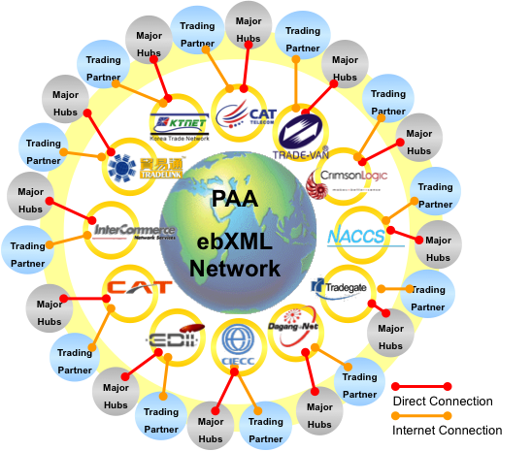

InterCommerce . . networking to the World
1987
Americas
United States
Asia
Japan, Korea, China, Hongkong, Macau, Taipei, Thailand, Malaysia, Singapore, Indonesia
2008
2010
European Union
27 Member States

Slide 5
InterCommerce NOW Linked to EU Customs
European Union
27 Customs Administrations
Multiple formats
Pan Asian eCommerce Alliance: PAA Network
Japan, Korea China
Taipei, Hongkong, Macau
Thailand, Malaysia, Indonesia, Singapore
ENS, eCO, SPS Certificate, etc.

Slide 6

APEC Automotive Dialog – Model Port Project:
BOI eCertificate of Authority to Import
PROJECT OUTLINE:
Motor Vehicles and
Parts and Components
Importation Process
Project
Proposal
Coverage
Phase I
Phase 2
Development of an
Automated Import Documentation System
Component 1: Upgrading of Databases
Component 2: Development of System Software
Component 3: Acquisition/
Setting-up of System Hardware
PILOT RUN
Automated Import
Documentation System Roll-off
Target Date: 2008-2009

Slide 7
METHODOLOGY:
Project Component 1:
Updating of a complete and accurate trade databases to support efficient application of the Automated Import Documentation System. Databases initially being identified are:
    Formula of manufacture per locally produce parts (covering complete knocked-down parts and components and raw materials)
    Correct tariff heading and duty of complete list of knocked down parts and components and raw materials used in the assembly of motor vehicles
    Established Home Consumption Value from the country of origin and/or similar blue book value
    CBU Vehicle production information

Slide 8
METHODOLOGY (continuation) :
Project Component 2:
Simplification/enhancement of process flow and documentation of importation by local manufacturer and distributor using IT automated system towards a paperless mode of transaction
Project Component 3:
Connectivity within the system shall be configured to attain efficiency of operation

Slide 9
Current Process Flow – BOI Permit, ATRIG, CP, CSR & LTO Registration
Manufacturer
BOI / BIR
BOC
LTO
Dealers
Landbank
PNP/TMG
Customer
CKD
Proforma Invoice
Process BOI Permit
CKD : 20 Days BOI Permit
Insurance
BL / SI / PL
Custom Clear.
Pay Taxes & Duties
2 Days
CKD
CBU
Insurance
BL / SI / PL
Custom Clear.
Process Custom Clear.
Custom Clearance & ATRIG
CKD : 4,300
CBU: 1,000/unit
Process BIR ATRIG
CBU : 6 Days BIR ATRIG
CKD
CBU
BOI – Imp.Permit
BIR - ATRIG
CKD
CBU
BOI – Imp.Permit
BIR - ATRIG
BIR - ATRIG
4 Days
Handle by Broker
BOI Permit/ATRIG
Frame & Eng. List
BOI Permit/ATRIG
Frame & Eng. List
CP Handling
Facilitation Fee : 1,000
Processing Fee: 2,200
CP Processing
CKD : 16 Days
CBU : 11 Days
Process CP
CP
(Green Copy)
CP
CP
(Orig. Copy)
5 Days
Prepare MAIDS Report
MAIDS Report
CP (Green Copy)
MAIDS Report
CP (Green Copy)
CSR Processing
Computer Fee : 132
CSR Fee:: 40
Total Fee / unit: 172
CKD : 2 Days
CBU : 2 Days
Process CSR
CSR
CSR
Legend:
CP – Certificate of Payment
BL – Bill of Lading
SI – Sales Invoice
PL – Parts List
CSR – Certification of Stock Report
SBR – Special Bank Receipt
OR – Official Receipt
CR – Certificate of Registration
ATRIG – Authority to Release Imported Goods
MAIDS – Manufacturers, Assemblers, Importers, Distributors, Stock Report
CSR
Distribute CSR to Dealers
SI
Dealers Report
Stencil
SI (Orig & Cc)
Dealers Report
CSR
Stencil
SI (Orig & Cc)
Dealers Report
CSR (Approved)
Stencil
1 Day
SI ( Cc)
PNP Clear. Form
Dealers Report
CSR / SBR
Stencil
1 Days
Unit Confirmation
SBR Payment
1 or 2 Days
Online Verification Fee: 40
Computer Fee: 132
Registration Fee : 1,400
Total Fee / unit: 1,572
SI ( Cc)
PNP Clearance
Dealers Report
CSR / SBR
Stencil
Fee : 200 / unit
Submit to LTO
PNP Clearance
Process LTO Reg.
OR
CR
OR
CR
1 or 2 Days
License Plate
License Plate
Release OR/CR & Plate

Slide 10
Current Process Flow : Manufacturer ->BOI ->BOC
Manufacturer
BOI / BIR
BOC
LTO
CKD
Proforma
Invoice
Process
BOI Permit
CKD : 20 Days BOI Permit
Insurance
BL/SI/PL
Customs Clearance
Custom Clearance & ATRIG
CKD : 4,300
CBU: 1,000/unit
Pay Taxes & Duties
2 Days
CKD
CBU
Insurance
BL/SI/PL
Customs Clearance
Process
Customs
Clearance
CP Handling
Facilitation Fee : 1,000
Processing Fee: 2,200
Process
BIR ATRIG
CBU : 6 Days BIR ATRIG
CKD
CBU
BIR ATRIG
BOI Import Permit
BIR ATRIG
CKD CBU
BOI Import Permit
BIR ATRIG
Handled
by Broker
4 Days
BOI Permit// ATRIG
Frame & Engine List
CP Processing
BOI Permit// ATRIG
Frame & Engine List
Legend:
CP – Certificate of Payment
BL – Bill of Lading
SI – Sales Invoice
PL – Parts List
CSR – Certification of Stock Report
SBR – Special Bank Receipt
OR – Official Receipt
CR – Certificate of Registration
ATRIG – Authority to Release Imported Goods
MAIDS – Manufacturers, Assemblers, Importers, Distributors, Stock Report
CKD : 16 Days
CBU : 11 Days
Process CP
CP
(Orig. Copy)
CP
CP
(Orig. Copy)
5 Days

Slide 11
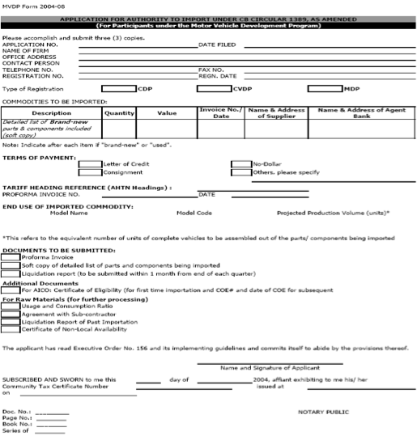
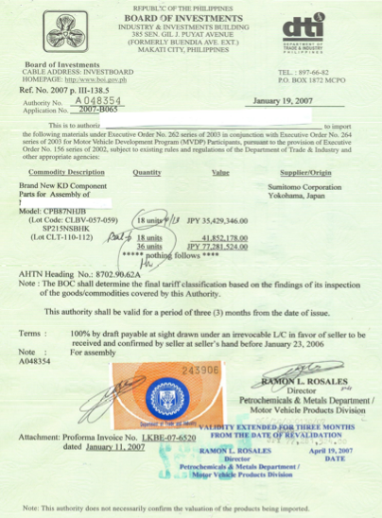
Certificate of Authority to Import (CAI)

Slide 12
Requisites from MVDP Participants
Registration
  BOI Trade System
  InterCommerce
Submission of the List of Importables
  Endorsement for Review
  Approval by BOI
Remit advanced deposits
  For eCAI Fees: BOI Cashier e.g. P6,500 for 10 eCAI
  For INS eCAI Transaction Fee: thru banks
User training

Slide 13




Board of Investments eCAI
MVPMAP
MCPPEA
Review of Listing of Imported
Vehicle Assembly Parts
BOI
Registered
MVDP
Participants
Importers’ Online Lodgment of eCAI –Certificate of Authority to Import Application
National
Single Window
Gateway
Trade System
- eCAI
eCAI to NSW
Invoice,
BL/AWB,
eCAI
Internet
VASP
Gateway
e2m IAS
Broker
Import Entry/
IEIRD SAD
Customs issued a Memo in November 2010, informing government agencies that it will no longer accept hard copies of import permits as support document to the Import Entry Declaration by Q1 2011 !

Slide 14
Alternative Import Permit Processes
Online Registration
Importer
Online Submission Import Permit Application Data
Manual Submission of NSW Import Permit
Application Form + Support Docs,
Payment of Fees
OGA
(Manual)
Import Permit
Status
NSW
Online Submission of eCAI,
Autodebit Payment of Fees
Approved
eCAI Data
OGA
(Auto)
Broker
Online Lodgment of Import Entry Declaration
BOC e2m
One Permit, One Import Entry !

Slide 15
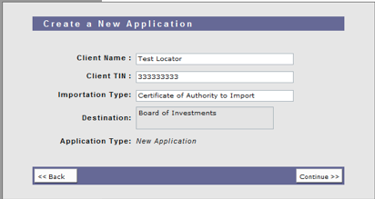
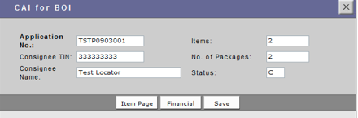
eCAI Application - Online

Slide 16
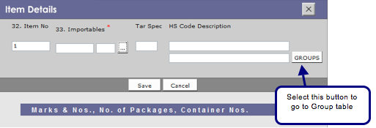
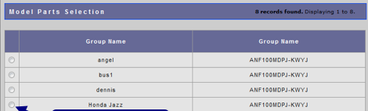

eCAI Application - Online

Slide 17
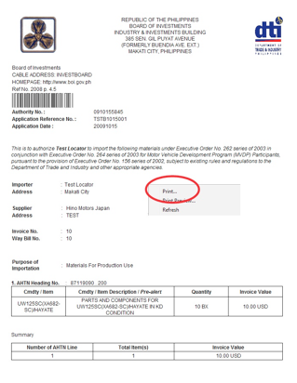
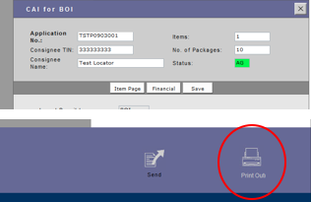
eCAI Application - Online

Slide 18
Manual CAI and e-CAI
Manual CAI
E-CAI
Manual preparation, submission of hard copy documents
Payment of P1,500 CAI fee before BOI receipt and processing
MDPMAP or MCPPEA review
Printing on security paper, BOI signatures
Valid for 3 months, multiple use and requires liquidation
Pre-approval (MVPMAP, MCPPEA, BOI) of importables based on BOM, and advanced deposits for eCAI fees
Online preparation using webforms, products in ‘Groups’, drop down menus
Electronic submission, automated processing, autodebit payment P650 eCAI fee and auto-approval
Online printing of eCAI
One-time use of eCAI, within 90 days from date of approval

Slide 19
Advantages of eCAI
Compliance to BOI and Customs policies
  EO on MVDP as amended
  BOC E2M and the National Single Window
Reduced cycle time
  5-10 minutes from submission to approval
  Processing and approval 24 x 7
Cost savings
  Man-hours in the preparation, submission, processing, approval and utilization of the CAI

Slide 20




InterCommerce’ Electronic Permits for Agencies and the National Single Window Interface
PEZA
Importer
Importers’ Online Lodgment of Import Permit/ Clearance Application
BAI BPI BFAR
Online Visibility: Import Permit/ Entry lodged, Assessment,
SSDT
National
Single Window
OGA Import Clearance/
Permit Data
Invoice,
AWB/BL,
Packing
List
Permits
Internet
Broker
Import Entry/
SAD
VASP
Gateway
e2m IAS

Slide 21
Q & A
InterCommerce Network Services, Inc.
Unit 501, The Pearlbank Center
146 Valero St., Salcedo Village, Makati
Telephone:
Gr
InterCommerce Network Services, Inc.
Unit 501, The Pearlbank Centre
146 Valero St., Salcedo Village, Makati
Telephone: +02-843-2792 Fax: +02-8438160
InterCommerce Network Services, Inc. (Cebu)
Ground Floor, Premier Business Loft
D. Jakosalem St., Cebu City
Gladys Gobangco
Telephone: 410-7660
Mobile: O922-8689139

